Slide 1
Getting data ready for network meta-analysis
Howard Thom

Slide 2












Network meta-analysis
Arm 2
$$d_{13}$$
1
3
Arm 2
$$d_{13}$$
$$d_{23}=d_{13}−d_{12}$$
$$d_{12}$$
$$d_{12}$$
Arm 1
Arm 1
$$d_{13}$$
$$μ_{2}$$
$$μ_{2}$$
$$d_{12}$$
$μ_{1}$
$μ_{1}$
2
RCT 1
RCT 2
NMA via consistency
A method for indirectly comparing interventions that have not been compared in a head-to-head RCT.
NMA often conducted in Bayesian framework using OpenBUGS software
This is linked from R using R2OpenBUGS

Slide 3
The problem
RCTs going into network meta-analyses are identified by a systematic literature review (SLR).
Data generated by the SLR is saved in a Data Extraction Sheet (DES).
DES rarely in the format needed for OpenBUGS NMA code
We need to write code that converts DES data to OpenBUGS NMA format

Slide 4

The application
Paper under review at Surgical Infections

Slide 5
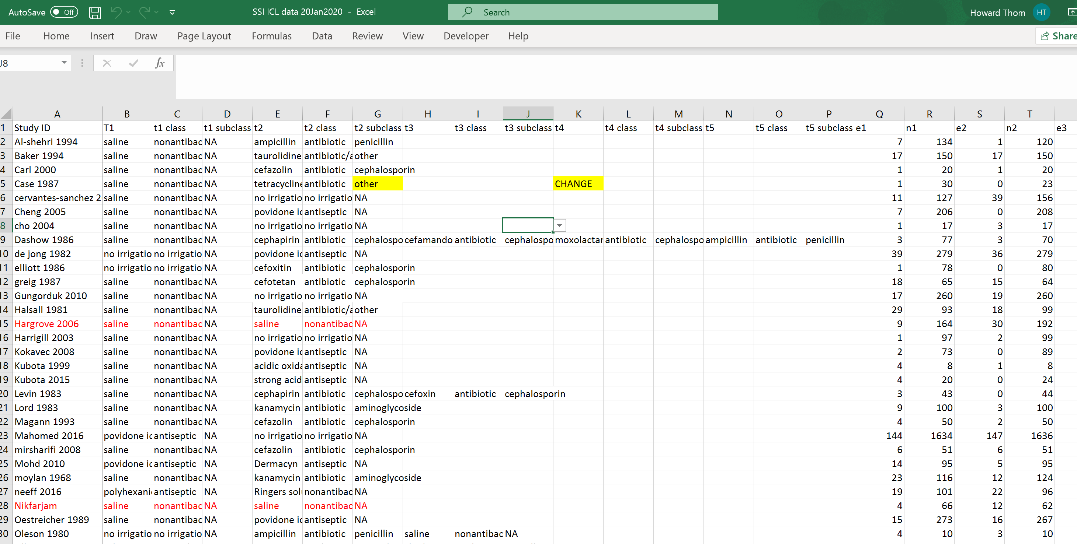
Raw data format
Note that this application is cleaner than most!
We only need to exclude ‘red’ studies and the numbers of events and patients don’t need to be imputed

Slide 6
Format needed by ROpenBUGS
ns is the number of studies
na[] is a vector of number of arms for each study
t[, ] is a numeric matrix with ns rows and max(na) columns. Each entry is the treatment in that arm
r[, ] is a numeric matrix with ns rows and max(na) columns. Each entry is the number of events in that arm
n[, ] is a numeric matrix with ns rows and max(na) columns. Each entry is the number of patients in that arm
Ideally need a mapping from numeric t[, ] to the actual treatment names
Niggles
Treatment numbers need to be in ascending order
The reference treatment (nonantibacterial irrigation) needs to be 1

Slide 7
Bonus – generate network plot
Can do this using our formatted data
Use existing code or write a new function, maybe with ggplot

Slide 8
Super stretch goal – generate forest plot
This first needs the OpenBUGS code to run

Slide 9
What do we want?
Goal
Increase efficiency of going from systematic literature reviews to network meta-analyses
Output
A script that is publicly available on GitHub
Statisticians can adapt to other situations going forward

